Slide 1
Yuma County COVID-19 Community Resource Guide
Notes:
Be specific and direct in the title. Use the subtitle to give the specific context of the speech.
-The goal should be to capture the audience’s attention which can be done with a quote, a startling statistic, or fact. It is not necessary to include this attention getter on the slide.

Slide 2
The Community Resource Guide is intended to be a comprehensive resource for individuals and families in the community who have been affected by the coronavirus outbreak.
Notes:
Dedicate this entire slide to the thesis statement. It is the reason the speech is being given. Use this time to reveal the three main points of the speech (slides 4,5,6) as an overview for the direction of the speech:
-[type main point #1 here]
-[type main point #2 here]
-[type main point #3 here]
Be sure to transition to the first main point and the next slide.

Slide 3
Our faith in a kind and provident God moves us, as a responsible community, to seek all the existing resources, both local and national, that are within the reach of our community, and share them with those who need them the most and thus, be able to direct and support them to be of their benefit. A community united in search of the common well-being, helps the individual to find himself/herself with a God who is always present among us.

Slide 4
Resources to be discussed
Test for COVID-19
Yuma County 2-1-1
Food meals and other services
Families with school-age children
P-EBT Replacement Benefits
For seniors and adults with disabilities
Orientation for loan resources
For small businesses
Notes:
Use the background points to post details that are not common knowledge, or that the audience will need to understand the context of the speech.
-Do not read these main points from the PowerPoint, instead elaborate on these points during the speech.

Slide 5
Resources to be discussed
Public Services Assistance
Financial resources
Economic Impact Payment
Local, state and national websites
Crisis or emergency information
Immigration Services
Notes:
Use the background points to post details that are not common knowledge, or that the audience will need to understand the context of the speech.
-Do not read these main points from the PowerPoint, instead elaborate on these points during the speech.

Slide 6
Test for COVID-19
First make a call
If you are concerned that you may have COVID-19 and experience symptoms such as fever or dry cough, call 1-844-549-1851 for a telephone test.
In person: must be ordered by a doctor
YRMC
Individual health care providers
Urgent care (Urgent Cares)
Commercial laboratories
Notes:
The counterargument should be the most common argument against the topic. The goal for this slide is to address the counterargument in such a way as to actually strengthen the original topic. Be sure to address each piece of evidence against the topic. As you address each piece of evidence elaborate on the text found on the slide. Remember to transition to the final slide, the action step.

Slide 7
Test for COVID-19 Yuma County Public Health
Sunset Health clinic:
The tests will be free for the community and Sunset Health will assist anyone who cannot obtain medical coverage.
Yuma - Sunset Health Clinic - 675 S Avenue B (Parking Lot)
Saturday: May 30, 2020 8 a.m. - 12 p.m. Only 300 available test kits available. They will be giving on a first come basis.
Also, Everyday testing with appointment: You can contact Sunset Health at 928-819-8999
Sunset Health - San Luis – 815 E. Cesar Chavez Blvd. San Luis, AZ 85349 - Offering COVID19 Testing Everyday Monday – Friday 8am-5pm
Sunset Health – Somerton – 115 N. Somerton Ave. Somerton, AZ 85350 - Offering COVID19 Testing Everyday Monday – Friday 8am-5pm
Sunset Health – Yuma – 675 S. Avenue B Yuma, AZ 85364 - Offering COVID19 Testing Everyday Monday – Friday 8am-5pm
Sunset Health – Yuma – 2060 W. 24th ST Yuma, AZ 85364 - Offering COVID19 Testing Everyday Monday – Friday 8am-5pm

Slide 8
Test for COVID-19 Yuma County Public Health
Regional Center for Border Health, Inc.
Testing available to anyone who may have been exposed or is the following symptoms: Fever, Dry cough, difficulty breathing. All insurance accepted & no one will be denied for inability to pay.
Walk up & Drive thru Locations:
Monday – Friday, 7 – 11 AM & 3 – 6 PM
Somerton Boarder Health, Inc, 950 Main Street 928-236-8001
San Luis Walk - In Clinic, Inc., 1896 Babbitt Lane
San Luis Urgent Care, Inc., 1233 Main Street- 928-550-5514
Saturday, 9AM – 9 PM
WWW.SLWIC.ORG

Slide 9
Yuma County
2-1-1 Arizona
Since July 2015 to June 2016, we met more than 1.2 million requests for health and human services through our call center and website
Website: https://211arizona.org/yuma/
Notes:
The counterargument should be the most common argument against the topic. The goal for this slide is to address the counterargument in such a way as to actually strengthen the original topic. Be sure to address each piece of evidence against the topic. As you address each piece of evidence elaborate on the text found on the slide. Remember to transition to the final slide, the action step.

Slide 10
Food
Supplemental Nutrition Assistance Program (SNAP) / Food Stamps
Follow this link to go to the Arizona State Eligibility Portal for SNAP and other benefits: https://www.healthearizonaplus.gov/
You can also call their toll-free number Monday through Friday from 7 am to 5 pm: 855-432-7587
Notes:
The counterargument should be the most common argument against the topic. The goal for this slide is to address the counterargument in such a way as to actually strengthen the original topic. Be sure to address each piece of evidence against the topic. As you address each piece of evidence elaborate on the text found on the slide. Remember to transition to the final slide, the action step.

Slide 11
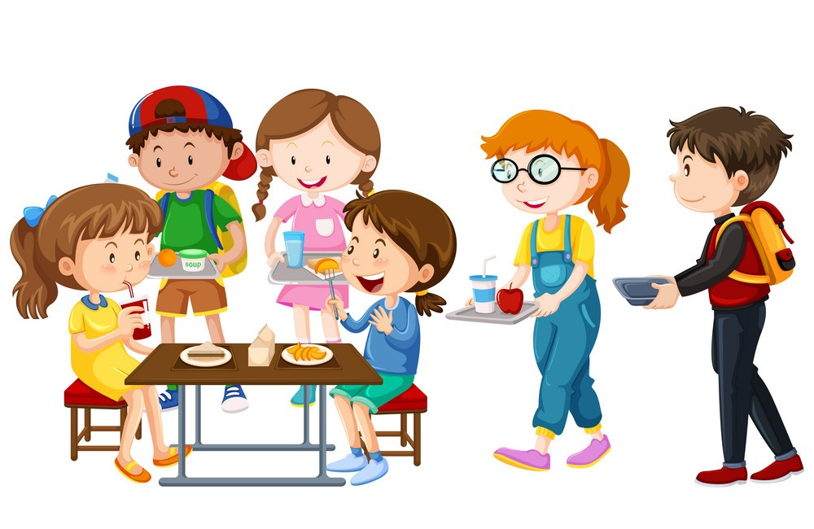
Food, meals and other services for families with school-age children
Many schools serve free to-go meals during the COVID-19 outbreak.
Children and teens ages 18 and under can receive free meals at participating locations throughout Yuma County. Call your school or visit their website for updated information on hours and locations of service..
Text FOOD to the number 877877.
Notes:
The counterargument should be the most common argument against the topic. The goal for this slide is to address the counterargument in such a way as to actually strengthen the original topic. Be sure to address each piece of evidence against the topic. As you address each piece of evidence elaborate on the text found on the slide. Remember to transition to the final slide, the action step.

Slide 12
Food, meals and other services for families with school-age children

Slide 13
Arizona P-EBT replacement benefits for school meals due to pandemic
What is EBT for the pandemic?
Pandemic EBT(P-EBT), as introduced in H.R. 6201, the Families First Coronavirus Response Act(link is external), provides assistance to households with children who are eligible for free or reduced-price school meals, while schools are out of session due to the COVID-19 pandemic. The Arizona P-EBT Pandemic School Meal Replacement Benefits program is a partnership between DES, the Arizona Department of Education, and the USDA Food and Nutrition Service.
How Does Pandemic EBT Work?
Eligible families will receive a pre-loaded Electronic Benefits Transfer (EBT) card that can be used to purchase groceries. Households currently receiving Nutrition Assistance and/or Cash Assistance benefits will have this additional benefit added to their existing EBT cards. This benefit is available for every child in the household that is enrolled in the Richard B. Russell National School Lunch Act program in Arizona.
Benefit Amount for Each Child
$120 for May
Note: Families who first start participating in the free and reduced-price school meal program after March 16 will receive Pandemic EBT benefits prorated to their start date, if their child is enrolled at a participating school.
Follow this link for more information: https://des.az.gov/es

Slide 14
Food, meals and other services for families with school-age children
Khan Academy, is a nonprofit organization with a mission to provide free world-class education during COVID-19 school closures. Resources include daily schedules for students ages 2-18 and remote learning resources.
https://www.khanacademy.org/
Notes:
The counterargument should be the most common argument against the topic. The goal for this slide is to address the counterargument in such a way as to actually strengthen the original topic. Be sure to address each piece of evidence against the topic. As you address each piece of evidence elaborate on the text found on the slide. Remember to transition to the final slide, the action step.

Slide 15
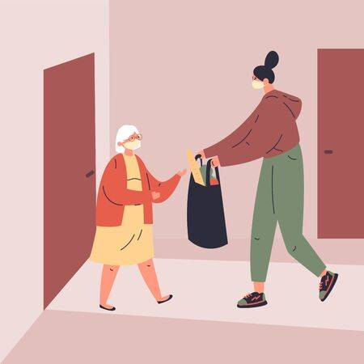
Food and meals for seniors and adults with disabilities
Arizona Supplemental Nutrition Assistance Program
The Arizona Supplemental Nutrition Assistance Program is a program of distributing a food package once a month to people over 60 years of age.
Applications are available at local food banks.
Notes:
The counterargument should be the most common argument against the topic. The goal for this slide is to address the counterargument in such a way as to actually strengthen the original topic. Be sure to address each piece of evidence against the topic. As you address each piece of evidence elaborate on the text found on the slide. Remember to transition to the final slide, the action step.

Slide 16
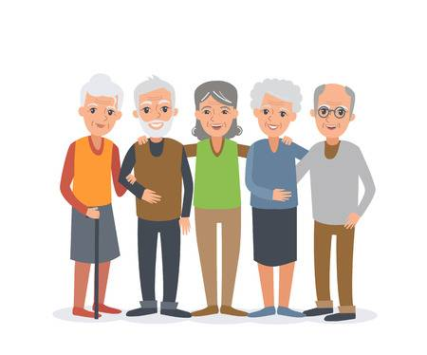
Food and meals for seniors and adults with disabilities
Yuma Senior Living offers a free lunch to seniors who need it. To schedule a free delivery or pickup call 928-388-6846 or email
jthomas@yumaseniorliving.com.
Call between 8 am and 12 pm to schedule for the following day; Meals are delivered in order to the first 30 people per day.
Notes:
The counterargument should be the most common argument against the topic. The goal for this slide is to address the counterargument in such a way as to actually strengthen the original topic. Be sure to address each piece of evidence against the topic. As you address each piece of evidence elaborate on the text found on the slide. Remember to transition to the final slide, the action step.

Slide 17
Small Business Loan Guidance and Resources
Coronavirus funding options
Guidance for Businesses and Employers
Local Assistance
Join the SBA's Relief Efforts
SBA Products and Resources
Government Contracting
https://www.sba.gov/coronavirus

Slide 18
Resources Available for Yuma County
Food delivery by the Food Bank at the Senior Center in San Luis, AZ.
WACOG will have a pre-registration for Public Services assistance for people over 65 and people with disabilities. Call the number 928 782-1886.
WACOG offers frozen home delivery meals for seniors in St. Louis, AZ, Somerton and Yuma, just call to request 1800 782-1886.
WACOG offers rental assistance in San Luis, AZ, Somerton and Yuma, the number to call is 928 782-3462.
WACOG also offers assistance to pay electricity, water and gas for people who have a contract with APS, Southwest Gas, in San Luis AZ, Somerton and Yuma, the number to call is 928 782-3462
https://www.wacog.com/

Slide 19
Public Services Assistance
Rental and mortgage assistance
The Save Our Home AZ (“SOHAZ”) Program offers Principal Reduction Assistance, Monthly Mortgage Subsidy Assistance for under and unemployed Arizonans and Second Lien Elimination Assistance to qualified Arizona homeowners.
https://housing.az.gov/save-our-home
Answer the questions below to see if you may qualify for rental payment assistance under the Arizona COVID Relief Program. This program is for Arizona residents only who meet other qualifying criteria. https://www.saveourhomeaz.gov/ra/

Slide 20
Public Services Assistance
Utilities
APS Crisis Bill Assistance Program - WACOG Yuma
Provides temporary crisis assistance of up to $ 800 to cover current or past due APS residential bills.
The Salvation Army Social Services - Yuma
Provides financial assistance for gas, heating fuel, water, and electricity bills to individuals with utility shutdown notices and bus tickets.
WACOG Utility Assistance Program
Provides financial assistance to pay for electricity, gas, propane, wood, and coal for low-income people.
Notes:
The counterargument should be the most common argument against the topic. The goal for this slide is to address the counterargument in such a way as to actually strengthen the original topic. Be sure to address each piece of evidence against the topic. As you address each piece of evidence elaborate on the text found on the slide. Remember to transition to the final slide, the action step.

Slide 21
Financial Resources
Unemployment benefits
The US Department of Labor issued a guide for state unemployment insurance programs to extend benefits to people whose employment status is affected by COVID-19. Visit the Arizona Unemployment Insurance Program portal to apply for benefits and file weekly claims or call them Monday through Friday from 8 am to 5 pm 877-600-2722 (toll free).
Notes:
The counterargument should be the most common argument against the topic. The goal for this slide is to address the counterargument in such a way as to actually strengthen the original topic. Be sure to address each piece of evidence against the topic. As you address each piece of evidence elaborate on the text found on the slide. Remember to transition to the final slide, the action step.

Slide 22
Financial Resources
Small Business Relief - Chicanos por la Causa
COVID-19 MICRO LOAN
PAYROLL PROTECTION (PPP)
https://cplc.org/blog/viewpost.php?id=1064
CARES Act Readiness Program – Learn Now. Take Action. Receive Funds
Free training program that helps both novice and experienced borrowers navigate the CARES Act and get access to the capital they need to sustain their business.
http://caresactaz.com/
Notes:
The counterargument should be the most common argument against the topic. The goal for this slide is to address the counterargument in such a way as to actually strengthen the original topic. Be sure to address each piece of evidence against the topic. As you address each piece of evidence elaborate on the text found on the slide. Remember to transition to the final slide, the action step.

Slide 23
Local, state and national websites
Yuma County COVID-19 Webpage
https://www.yumacountyaz.gov/home
Find food assistance, help paying bills, and other free or reduced cost programs, including new programs for the COVID-19 pandemic
https://findhelp.org/
Notes:
The counterargument should be the most common argument against the topic. The goal for this slide is to address the counterargument in such a way as to actually strengthen the original topic. Be sure to address each piece of evidence against the topic. As you address each piece of evidence elaborate on the text found on the slide. Remember to transition to the final slide, the action step.

Slide 24
Local, state and national websites
Domestic violence services
https://www.thehotline.org/
Call 1-800-799-7233
Arizona COVID-19 RESOURCES AND TIPS
http://aztownhall.org/COVID-19-Resources
Notes:
The counterargument should be the most common argument against the topic. The goal for this slide is to address the counterargument in such a way as to actually strengthen the original topic. Be sure to address each piece of evidence against the topic. As you address each piece of evidence elaborate on the text found on the slide. Remember to transition to the final slide, the action step.

Slide 25
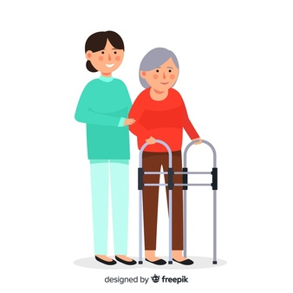
Crisis or emergency information
A team of nurses and mental health personnel available to assist those experiencing a crisis and in need of immediate assistance, 24 hours a day, 365 days a year.
If you are in immediate crisis, either for yourself or your loved one, call the community crisis line
1 (866) 495-6735
Notes:
The counterargument should be the most common argument against the topic. The goal for this slide is to address the counterargument in such a way as to actually strengthen the original topic. Be sure to address each piece of evidence against the topic. As you address each piece of evidence elaborate on the text found on the slide. Remember to transition to the final slide, the action step.

Slide 26
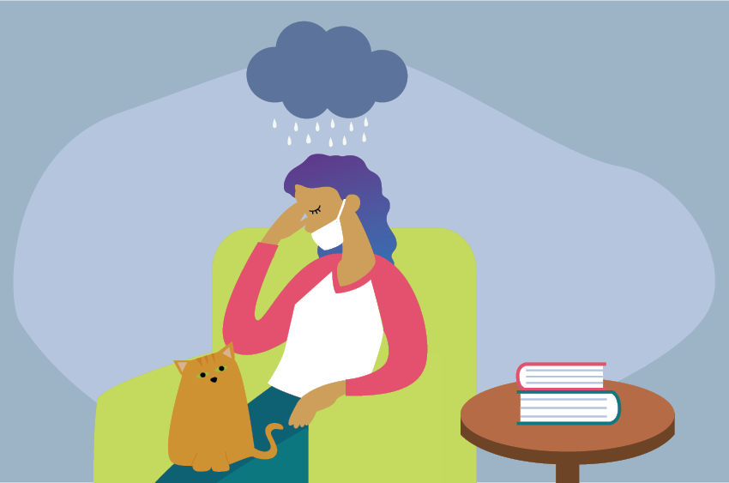
Substance Abuse Treatment
Locate a treatment provider near you on the Substance Abuse and Mental Health Services Administration (SAMHSA) website https://www.samhsa.gov/find-treatment
Notes:
The counterargument should be the most common argument against the topic. The goal for this slide is to address the counterargument in such a way as to actually strengthen the original topic. Be sure to address each piece of evidence against the topic. As you address each piece of evidence elaborate on the text found on the slide. Remember to transition to the final slide, the action step.

Slide 27
Catholic Community Services
Services offered
Safe House – Domestic Violence Shelter
Daybreak Adult Day Health Care
Counseling - CCS-Yuma
Senior Nutrition – Congregate Meals - CCS-Yuma
Senior Nutrition – Home-Delivered Meals - CCS-Yuma
https://www.ccs-soaz.org/home
(928) 341-9400
Notes:
The counterargument should be the most common argument against the topic. The goal for this slide is to address the counterargument in such a way as to actually strengthen the original topic. Be sure to address each piece of evidence against the topic. As you address each piece of evidence elaborate on the text found on the slide. Remember to transition to the final slide, the action step.

Slide 28
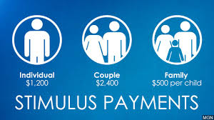
Economic Impact Payment
If you have not yet received your “Economic Impact Payment” of $ 1,200 click here: https://www.irs.gov/coronavirus/economic-impact-payments
Go to "Get My Payment“
Will need:
Social Security number
Date of birth
Address on your last income tax report
To add your bank information, have the following at hand:
Copies of 2018 or 2019 income taxes
Routing number and your bank account number
Notes:
The counterargument should be the most common argument against the topic. The goal for this slide is to address the counterargument in such a way as to actually strengthen the original topic. Be sure to address each piece of evidence against the topic. As you address each piece of evidence elaborate on the text found on the slide. Remember to transition to the final slide, the action step.

Slide 29
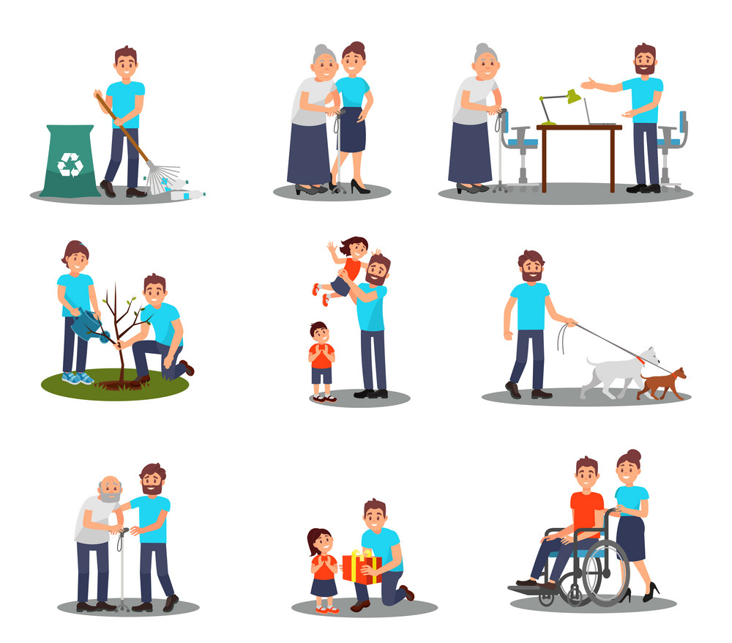
What can you do to help?
Inform yourself and follow the recommendations of the CDC
https://www.cdc.gov/coronavirus/2019-nCoV/index.html
Notes:
The counterargument should be the most common argument against the topic. The goal for this slide is to address the counterargument in such a way as to actually strengthen the original topic. Be sure to address each piece of evidence against the topic. As you address each piece of evidence elaborate on the text found on the slide. Remember to transition to the final slide, the action step.

Slide 30
Immigration law
Immigration law
American Beginnings- Proyecto San Pablo
Address: 2215 S 8th Ave., Yuma, AZ 85364 (928) 783-5794
Campesinos sin Fronteras
663 E Main St Ste A, Somerton, AZ 85350 (928) 627-5995
800 E Cesar Chavez Blvd, San Luis AZ 85349 (Fernando Padilla CC) (928) 627-1060
- Services are provided to all community including farm working families, new immigrants, and individuals with low-income families to improve quality of life.
- Behavioral Health: Domestic Violence, DUI, licensed substance abuse treatment and Anger Management services.

Slide 31
Resources for Catholics at the Home
http://www.usccb.org/about/communications/resources-for-catholics-at-home-during-covid-19.cfm
Notes:
The counterargument should be the most common argument against the topic. The goal for this slide is to address the counterargument in such a way as to actually strengthen the original topic. Be sure to address each piece of evidence against the topic. As you address each piece of evidence elaborate on the text found on the slide. Remember to transition to the final slide, the action step.

